Slide 1
Discrete Mathematics
Spring 2020
Yuan Ze University

Slide 2
The pigeonhole principle

Slide 3
Born in the same month

Slide 4
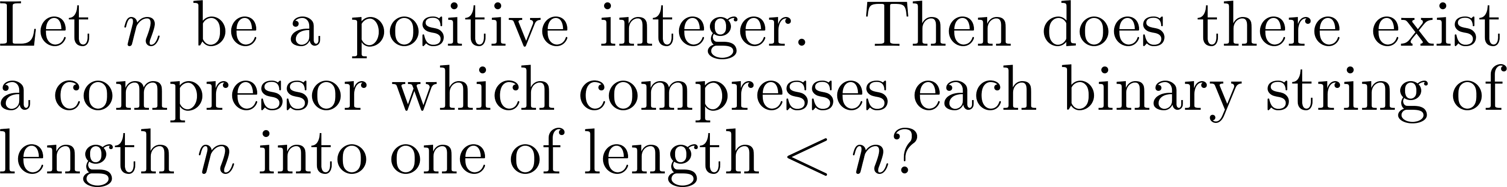
Magic compression

Slide 5
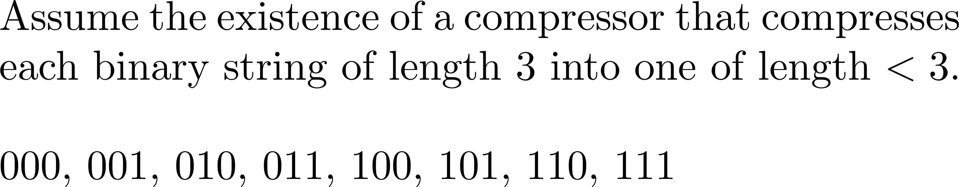

An illustration
How do you decompress?

Slide 6
Long division

Slide 7
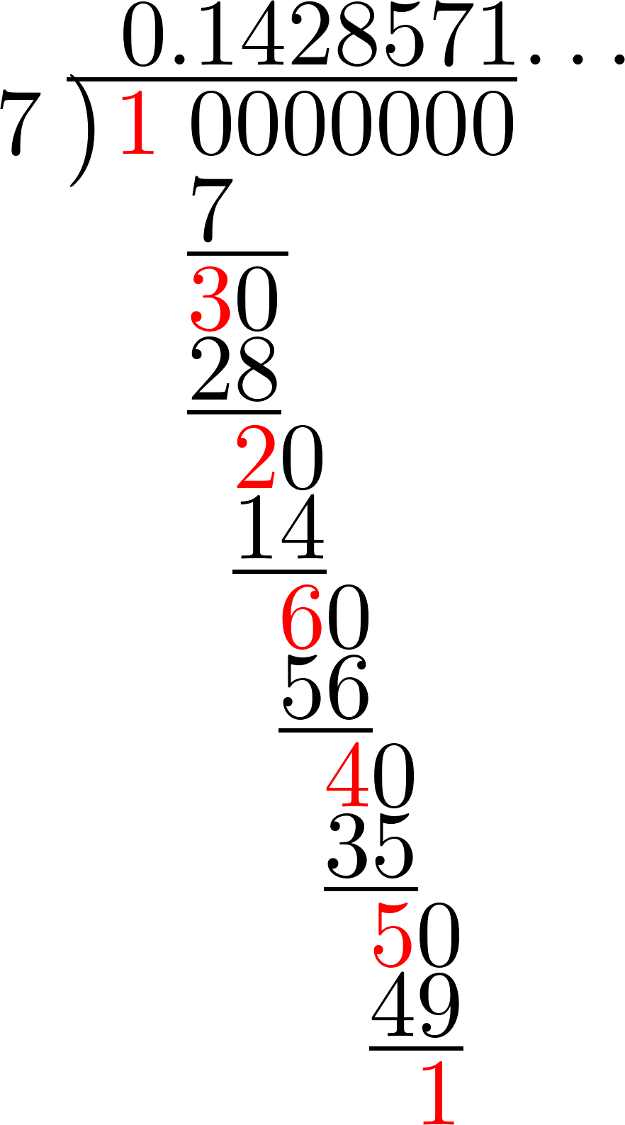

Slide 8
Mutual friends
Any group of two or more people must contain two persons with the same number of mutual friends.
Left as a quiz.

Slide 9
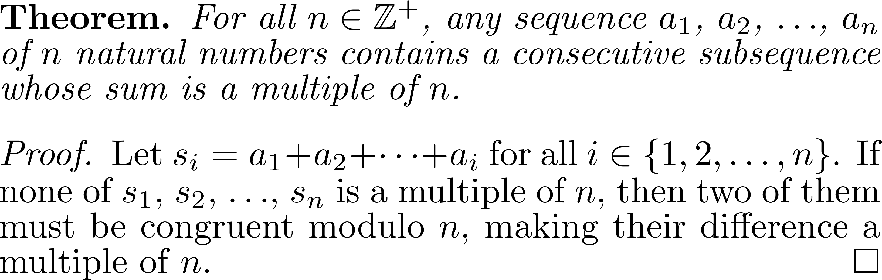
Summing numbers

Slide 10
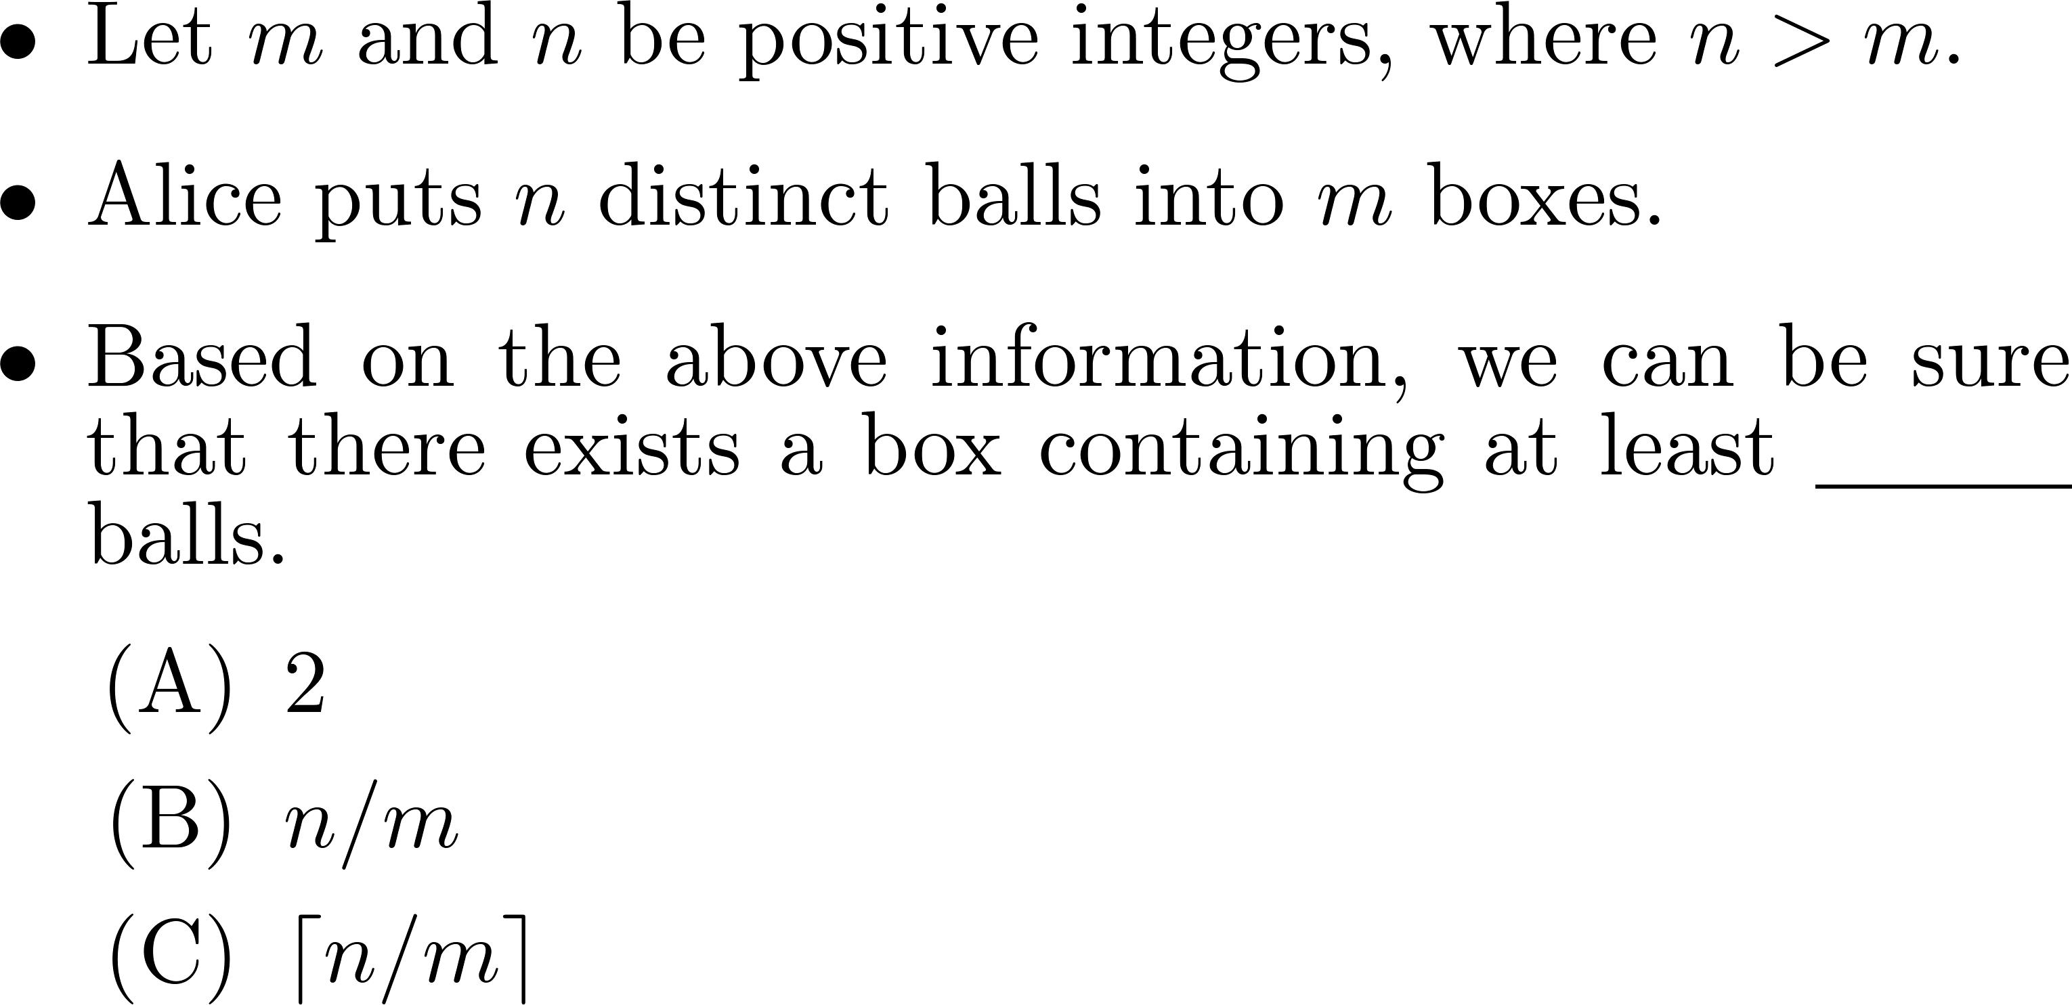
A generalization

Slide 11
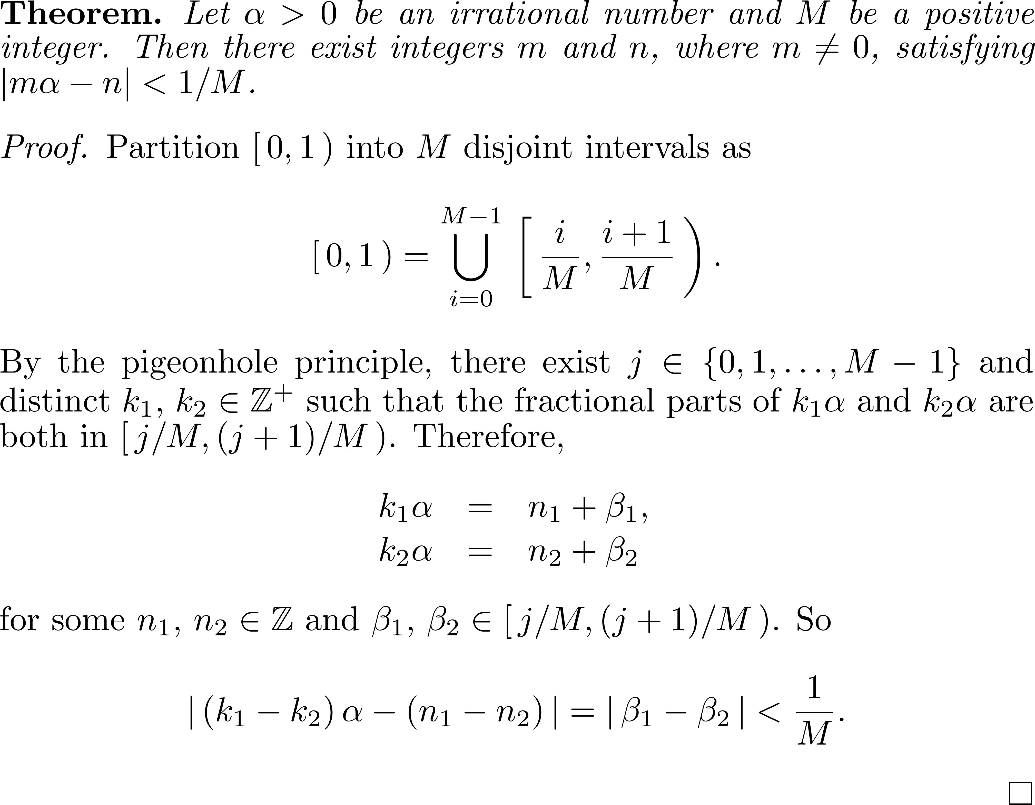

Slide 12
Reading assignment
請閱讀以下網頁的第一頁http://episte.math.ntu.edu.tw/articles/mm/mm_02_4_07/index.html

Slide 13
Comments and questions?

